Slide 1



Airlines Analysis Report
Comprehensive analysis of flight data in 2022.
Powered by : Mostafa Gasser

Slide 2
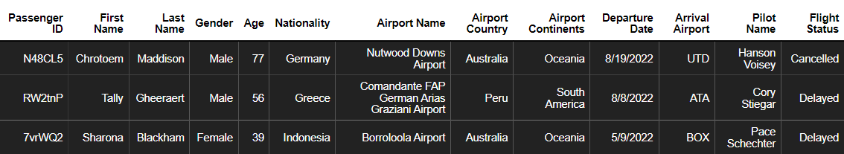
About Dataset : Airline data helps improve flight operations, enhance customer experiences, and ensure safety.
Data Overview
Data Columns
Passenger ID : Unique identifier for each passenger
First Name : First name of the passenger
Last Name : Last name of the passenger
Gender : Gender of the passenger
Age : Age of the passenger
Nationality : Nationality of the passenger
Airport Name : Name of the airport where the passenger boarded
Airport Country : Country of the airport's location
Airport Continent : Continent where the airport is situated
Departure Date : Date when the flight departed
Arrival Airport : Destination airport of the flight
Pilot Name : Name of the pilot operating the flight
Flight Status : The Current status of the flight (e.g., on-time, delayed, canceled)

Slide 3
Analysis of Traveler Behaviors and Flight Performance
Objective :
This report aims to provide valuable insights into passenger behavior and flight performance across different time periods. Specifically, we seek to:
Enhance understanding of air travel patterns and their impact on operational performance
Identify opportunities for improving efficiency and customer experience
Scope of Analysis :
Passenger Demographics
Flight Performance
Operational Metrics
Geographical Analysis
Trends

Slide 4
Let’s Jump Into Our Q&A

Slide 5
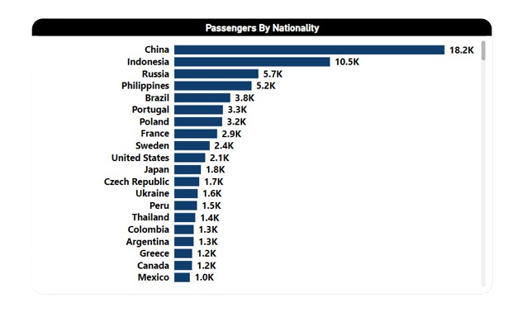
Passenger Demographics
What is the distribution of passenger nationalities?

Slide 6
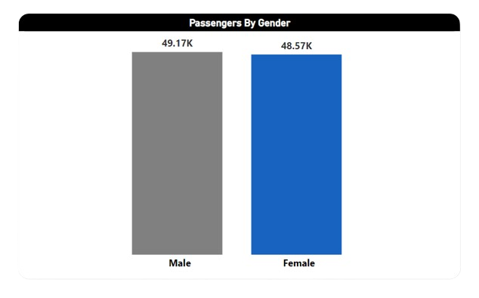
Passenger Demographics
What are the passenger distributions by gender?

Slide 7
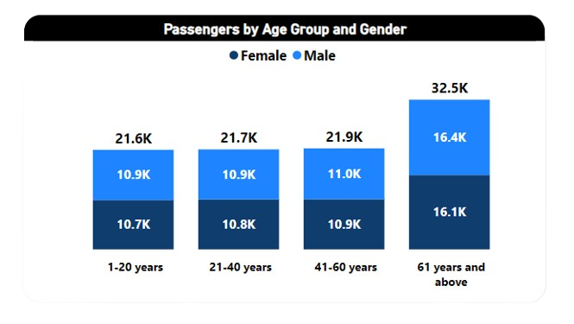
Passenger Demographics
What are the passenger distributions by age group and gender?

Slide 8
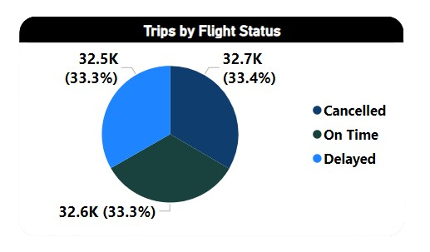
Flight Performance
What are the percentage distributions of flight statuses ?

Slide 9
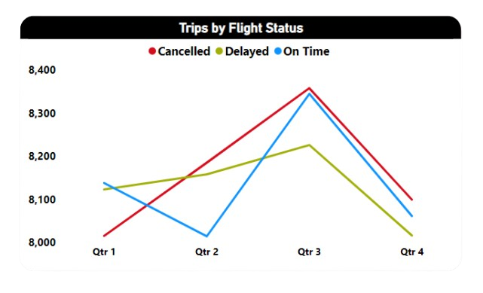
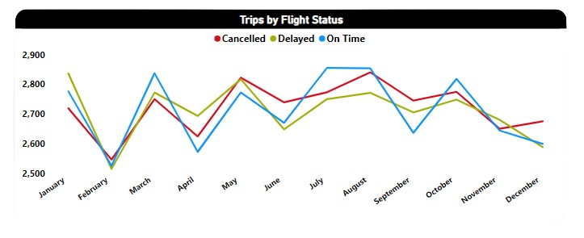
Flight Performance
What is the percentage distribution of flight statuses (on-time, delayed, canceled) for each quarter and for each month?

Slide 10
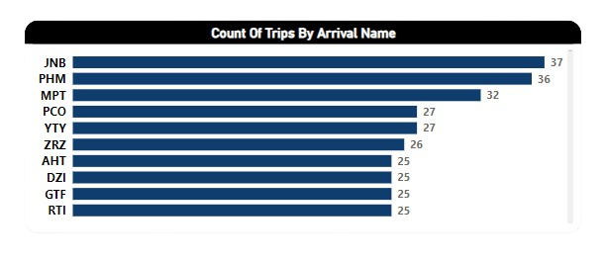
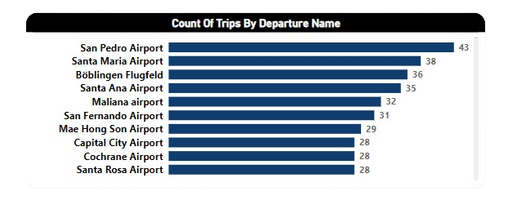
Operational Metric
Which airports are the busiest in each country in terms of departure and arrival flights?

Slide 11
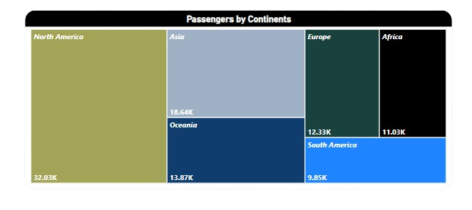
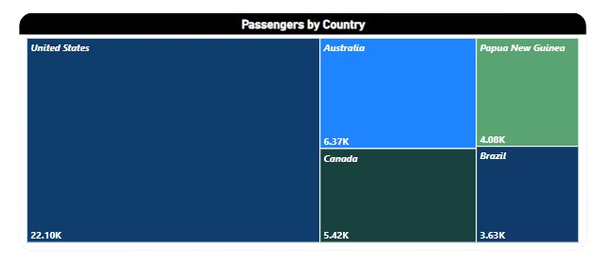
Geographical Analysis
Which country and continent have the highest number of departing passengers?

Slide 12
Now, let’s dive into our dashboard and explore the key insights we've uncovered.

Slide 13

Although we've gained insights, here are some recommendations to consider

Slide 14
Recommendations
Focus on top countries routes: USA, Australia, Guinea, Brazil, China.

Slide 15
Recommendations
With a significant number of passengers aged 61 and above, introduce senior-friendly services and amenities across all touch points.

Slide 16
Recommendations
Develop marketing campaigns that target both genders equally while considering the specific needs and preferences of each group

Slide 17
Recommendations
With many flights delayed or canceled, it's crucial to develop programs that keep customers happy and offer compensation, which can enhance loyalty

Slide 18
Thank you

